Slide 1
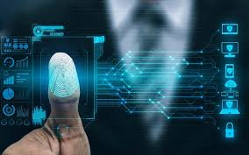
BIOMETRICS IN CYBER SECURITY

Slide 2
Content
Introduction
Physical and Behavioral Characteristics
Biometric system
Criteria of biometrics
Basic components of biometric system
Applications
Examples

Slide 3
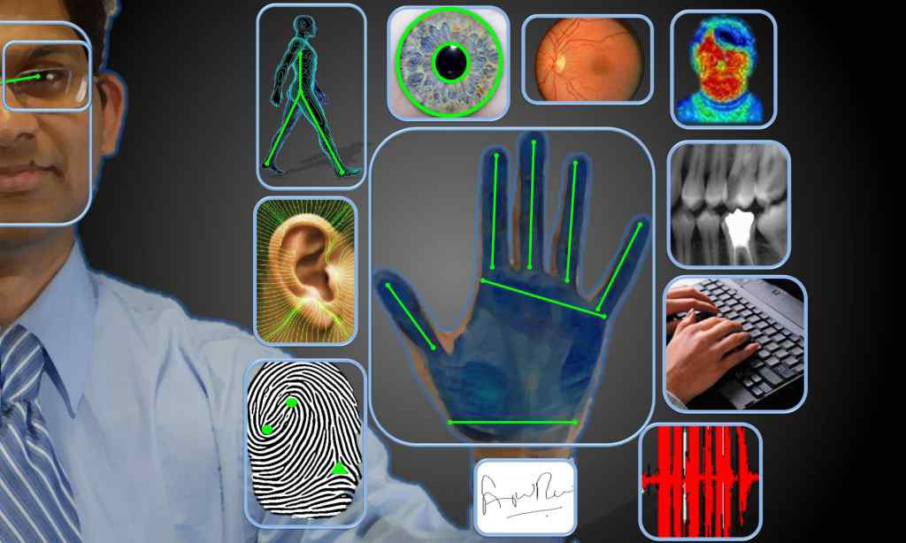
Introduction to Biometrics in Cyber Security
Biometrics is a technology used to identify,
analyse and measure an individual’s physical
and behavioral characteristics.
Biometrics is increasingly being used as an
authentication method in cyber security.
The term “Biometrics ” is derived from
Greek word “bio” which means “life” and
metric means to “measure”.

Slide 4
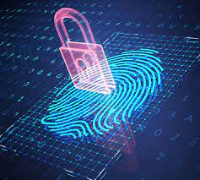
Biometric is a powerful combination of
science and technology that can be use
to protect and secure the most valuable
information and property.
Humans have two types of characteristics :
1) Physical Characteristics
2) Behavioral Characteristics

Slide 5
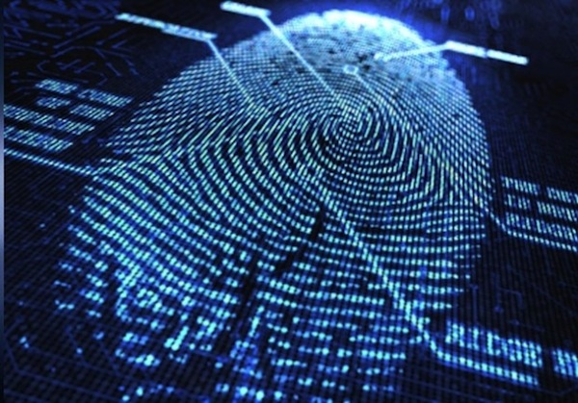
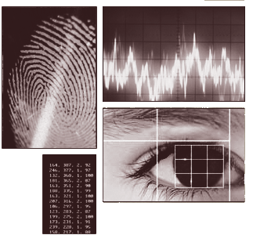
Physical Characteristics
Biometric identifiers are often categorized
as physiological characteristics which are
related to the shape of the body.
Examples :
Fingerprint, palm veins, face recognition,
DNA, palm print, hand geometry,
iris recognition, retina etc.

Slide 6
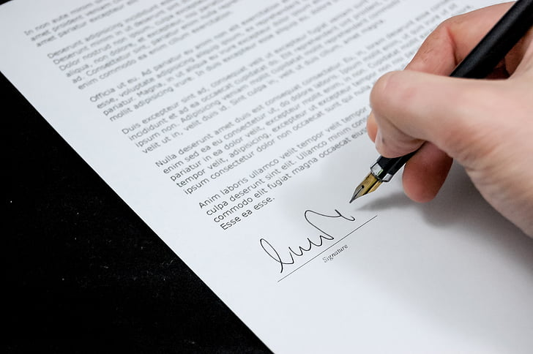

Behavioral Characteristics
Behavioral biometrics is the field of study related to the measure of uniquely identifying and measurable patterns in human activities
Behavioural biometric verification methods include tone, speaking voice , signature, typing, writing skills etc.

Slide 7
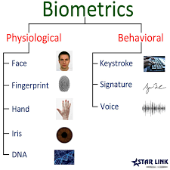

Slide 8
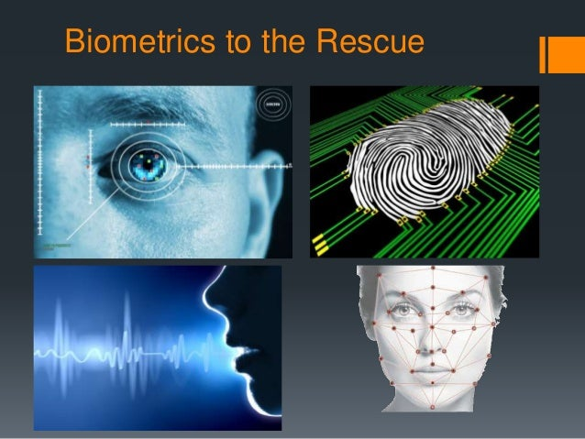
Biometric system
A biometric system is a technology which takes
an individual’s physiological, behavioral, or
both traits as input, analyzes it and identifies
the individual as genuine or malicious user.
Biometrics offers a higher level of security
compared to traditional password-based
authentication methods.
Biometrics refers to the measurement and analysis
of unique physical or behavioral characteristics
for authentication purposes.

Slide 9
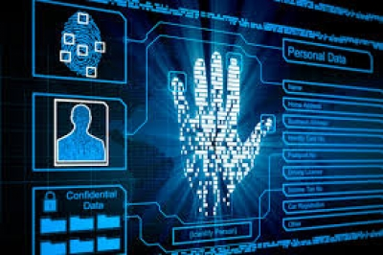
Criteria of Biometrics
There are seven characteristics of biometrics :
1)Universality
2) Uniqueness/ distinctiveness
3) Permanence
4)Collectability/Measurability
5) Performance
6) Acceptability
7)Circumvention

Slide 10
1)Universality:
Universality means that every person using a system should possess the trait.
2) Uniqueness:
means the trait should be sufficiently different for individuals in the relevant population such that they can be distinguished from one another.
3) Permanence:
Permanence relates to the manner in which a trait varies over time. The trait should exist for longer time.
4)collectability:
Measurability (collectability) relates that how easy it is to acquire a characteristics with which we can later authenticate a user.

Slide 11
5) Performance:
Performance relates to the accuracy, speed, and robustness of technology used.
6) Acceptability:
Acceptability relates to how well individuals in the relevant population accept the technology such that they are willing to have their biometric trait captured and assessed.
7)Circumvention:
Circumvention relates to the ease with which a system can be ticked by a falsified biometric identifier. It is a action of overcoming a problem or difficulty.

Slide 12
Basic Components of biometric system
Data store
Input
Interface
(Sensor)
Processing
Unit
Output
Interface

Slide 13
Applications of Biometrics
There are 3 main applications
1)Commercial Applications: Electronic data security , e-commerce Internet access ATM, credit cards, phones, banking ,etc.
2)Government Applications: Nationalized ID cards such as Pan card, Aadhar card, its very confidential data.
3)Forensic Applications: DNA , Blood samples

Slide 14
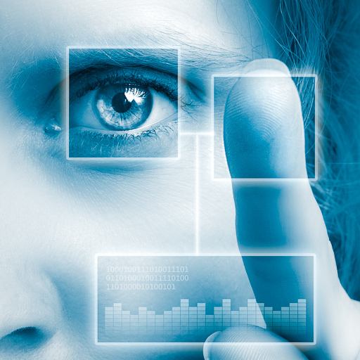
Examples of Biometrics in Cybersecurity
Mobile devices: Biometrics are commonly used for unlocking smartphones and
authorizing mobile payments.
Online banking: Biometric authentication
provides an additional layer of security for
online banking transactions.
Aadhaar card: figure print Mapping ,iris
recognition, palm print mapping are used here.
Border control: Biometrics are used at
border control checkpoints to verify
travelers' identities and enhance security.

Slide 15
THANK YOU

